Slide 1

Fraud Detection in Credit Card Transaction
Xi Qian

Slide 2
Table of Contents
Problem Statement
Dataset Info
EDA findings
Feature Engineering
Modeling
Results & Analysis
Conclusion & Further Thoughts

Slide 3
Problem Statement
Fraud is billion-dollar business and it is increasing every year, especially, fraud that involves customer credit card transaction represent significant problems for business and customer themselves.
Although fraud instances are not identical, they can be similar in content and appearance by looking at history data. People may improve the efficacy of fraudulent transaction alerts for millions of people around the world, helping hundreds of thousands of businesses reduce their fraud loss and increase their revenue.

Slide 4
Dataset Info
Vesta Corporation – leading payment service company
Data from its real-world-ecommerce transactions
Dataset size:
Training Set: ~560k observations, 434variables
Testing Set: ~500k observations, 433 variables
Variables Info
Transaction dataset: categorical variables & numerical variables
Identity dataset: categorical variables

Slide 5
Variable Info
Transaction related variables:
Categorical variables:
Product Category: M/C/W…
Card1-Card6: payment card information – card type(credit/debit), issue bank, etc
Addr1, Addr2
P_emaildomain, R_emaildomain: Purchaser and recipient email domain – gmail, etc
M1-M9: information masked – match, such as names on card and address, etc
Numerical variables
TransactionDT: timedelta from a given reference datetime
TransactionAMT: transaction amount
Dist: how far the transaction away from cardholder’s home/work place
C1-C14: information masked – counting, such as how many address are found to be associated with the payment card
D1-D15: timedelta, such as days between previous transaction
Vxxxx: Vesta engineered rich features, including ranking, counting and other entity relations
Identity related variables
Categorical variables:network connection info (IP/ISP)digital signature (browser/version, etc) associated with transactions
Device Type: mobile/desktop
Device Info
Id_12-Id38

Slide 6
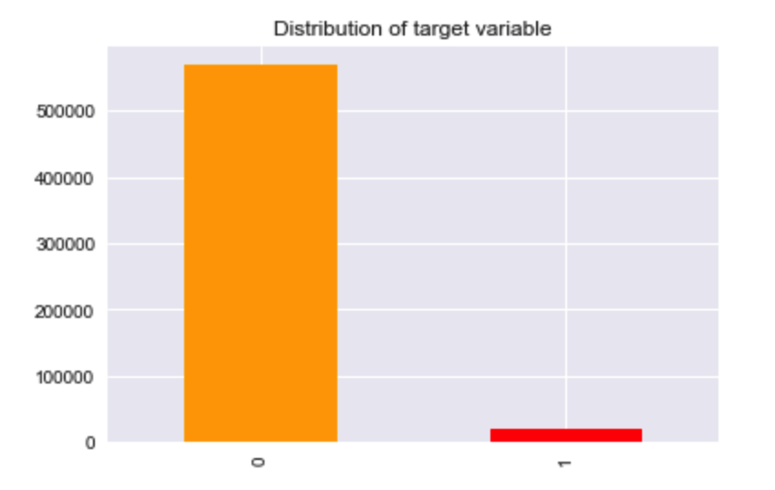
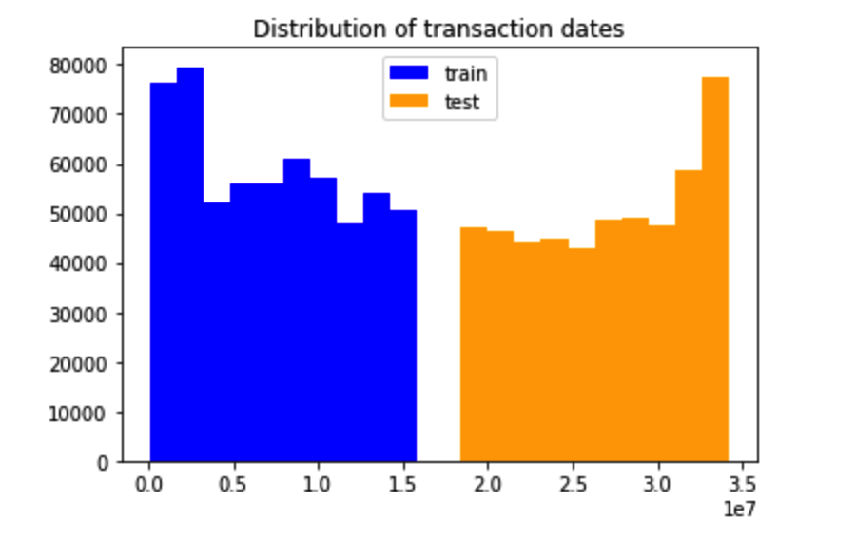
Exploratory Data Analysis
Findings

Slide 7
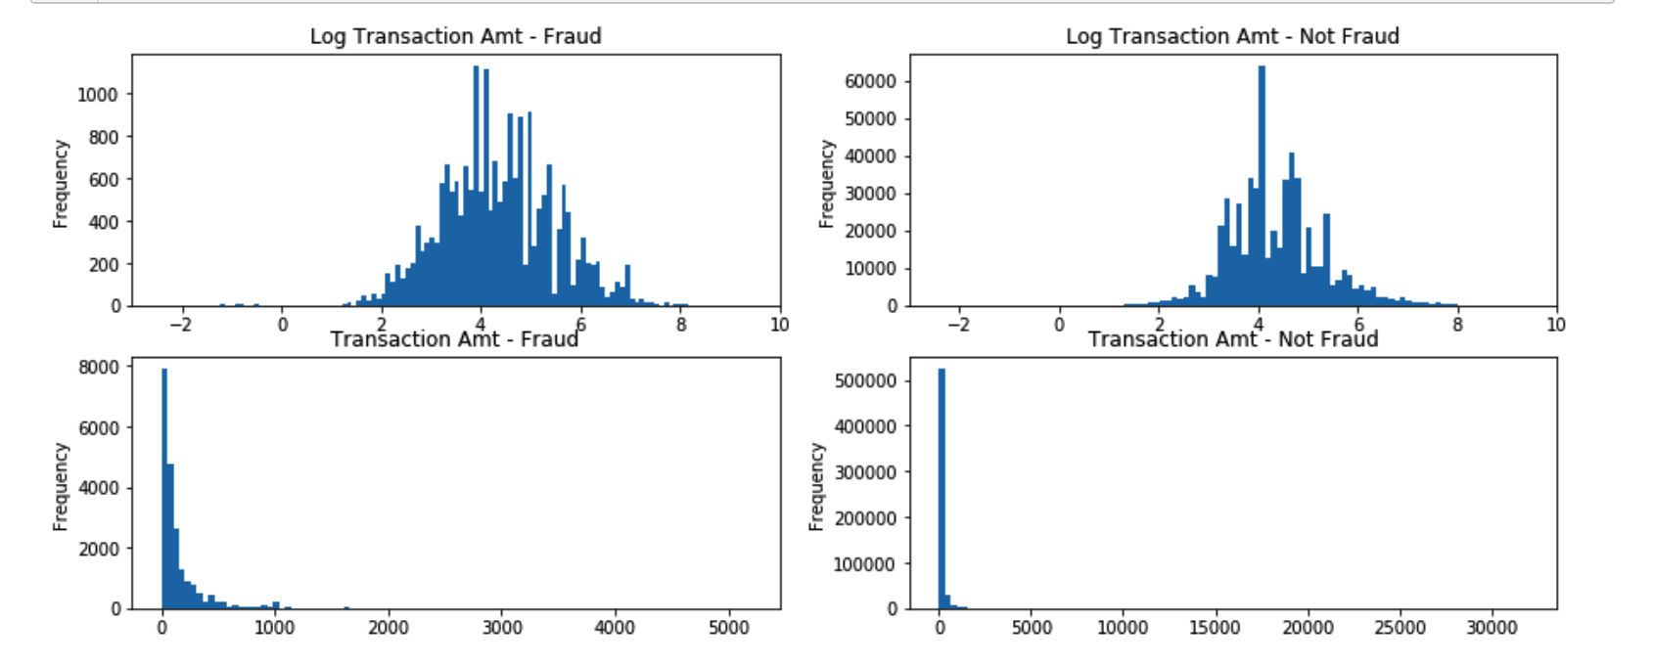
Exploratory Data Analysis
Findings

Slide 8
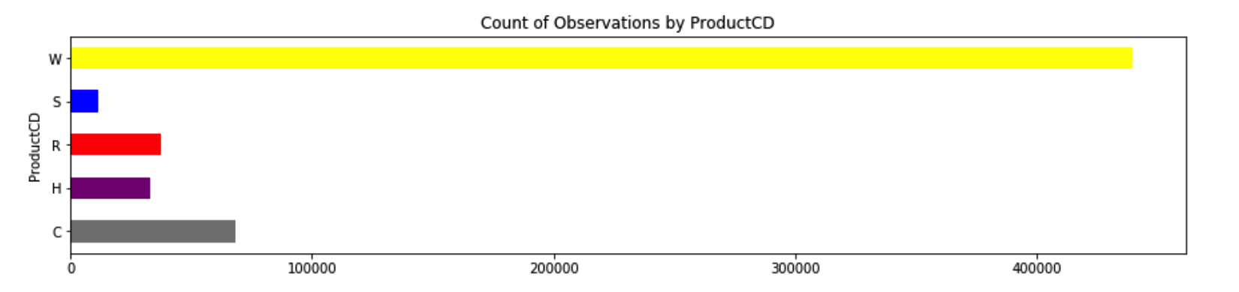
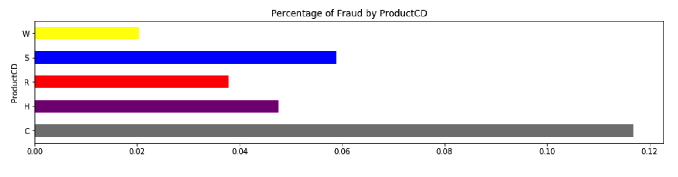
Exploratory Data Analysis
Findings

Slide 9
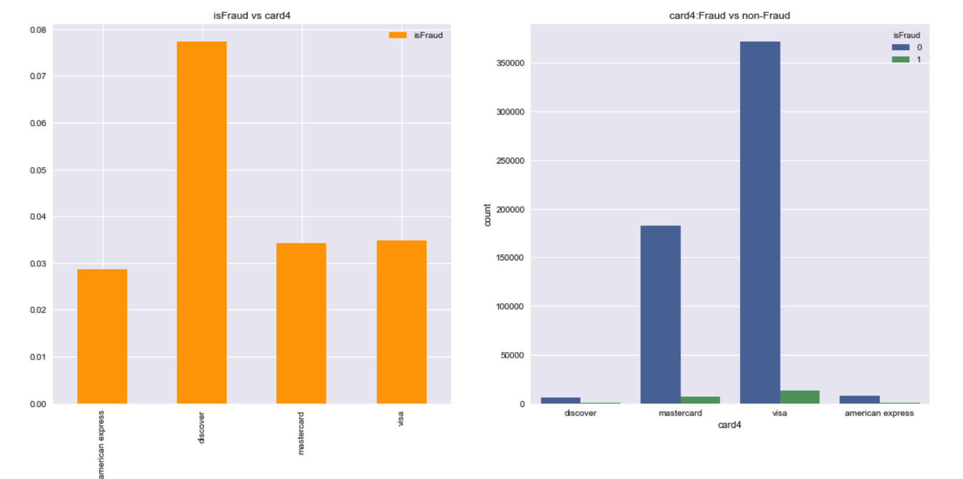
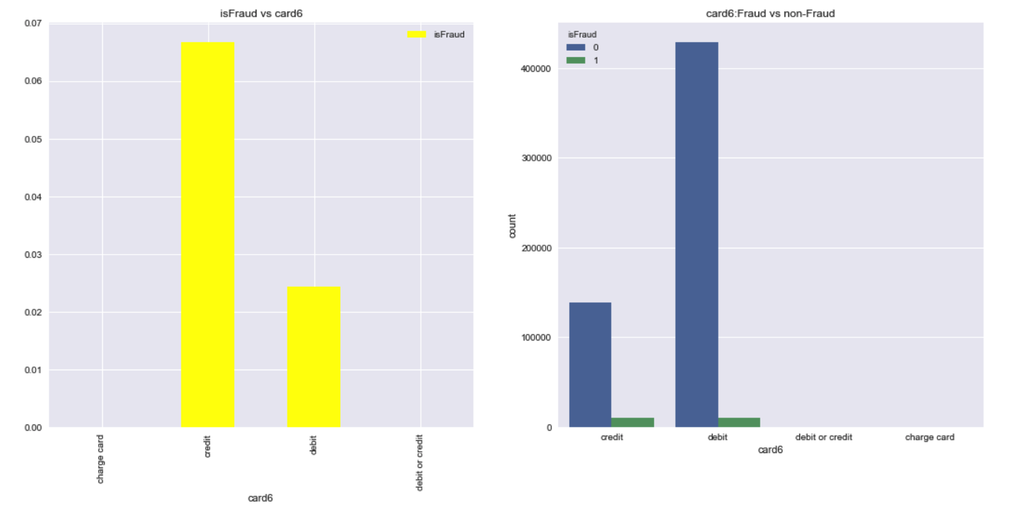
Exploratory Data Analysis
Findings

Slide 10
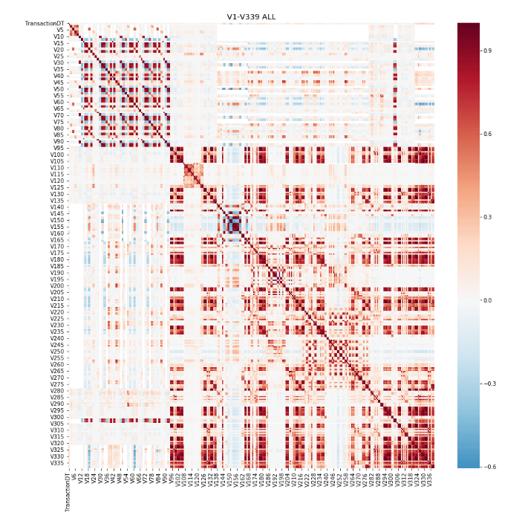
Exploratory Data Analysis
Correlation Analysis

Slide 11
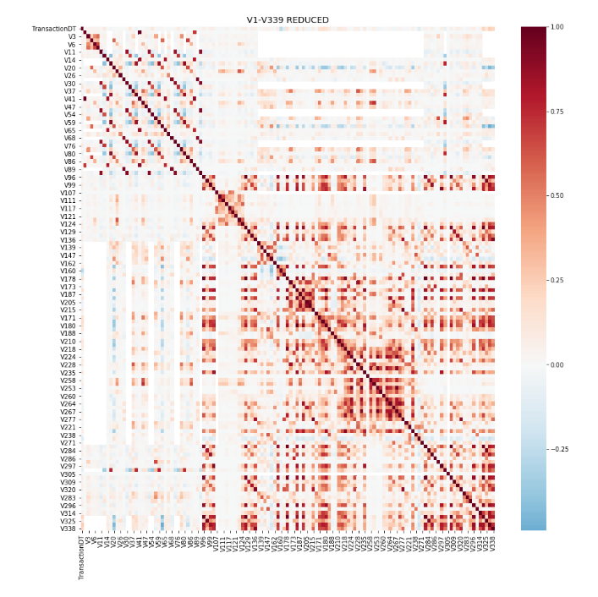
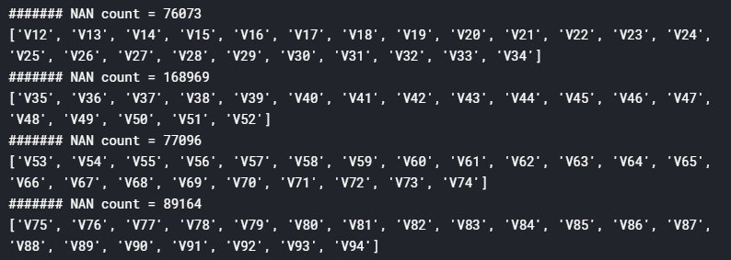
Feature Engineering
NAN Processing

Slide 12
Feature Engineering
Further Dimensionality Reduction methods
especially for variables V1-V335
applied PCA on group individually
selected a maximum sized subset of uncorrelated columns from each group
replaced the entire group with all columns averaged.

Slide 13
Feature Engineering
Dummy Variables
card6 – card type (credit/debit/..), etc
Regrouping: based on frequency of fraud cases occur in each group
card4 – type 1: discover/American express
type 2: visa/mastercard
Device info: Windows/iOS device/MacOS vs other
Frequency Encoding
Device Type: Desktop/mobile
Product Category: W/S/C/H/R

Slide 14
Modeling
TimeSeries Split
num of splits = 5
Models: LightGBM & Xgboost – reasons to use
Hyper-parameter tuning

Slide 15
Results & Analysis
Overall Average accuracy: 3.5% of fraud cases in training set
LightGBM result | Fold 1 | Fold 2 | Fold 3 | Fold 4 | Fold 5
Training Set | 0.95745 | 0.997002 | 0.999465 | 0.991157 | 0.988608
Validation Set | 0.872766 | 0.911545 | 0.924285 | 0.922122 | 0.917767
XGBoost result | Fold 1 | Fold 2 | Fold 3 | Fold 4 | Fold 5
Training Set | 0.97643 | 0.984565 | 0.992463 | 0.993552 | 0.987252
Validation Set | 0.95353 | 0.964523 | 0.974672 | 0.975562 | 0.963622
 | Best Accuracy (Testing Set)
LightGBM | 0.9656
XGBoost | 0.9794

Slide 16
Further Thoughts
Model Performance Metrics – Imbalanced Dataset
AUC, accuracy
Confusion Matrix - Cutoff point Analysis
Improvements:
(1) Handle Imbalanced Class: (a) Over-sampling (b) Under-sampling
(2) Try unsupervised learning algorithm on the dataset, figuring if there is similar anomaly characteristics exist in these fraud cases

Slide 17
Thank you. Questions?

